Slide 1
EV3 Core Set (45544) Top Tray Organizer

Slide 2
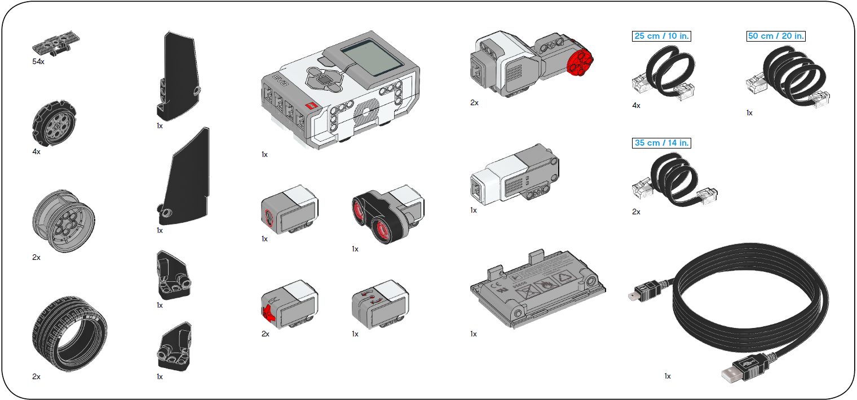
EV3 Core Set (45544) Bottom Tray Organizer

Slide 3
EV3 Expansion Set (45560) Top Tray Organizer

Slide 4
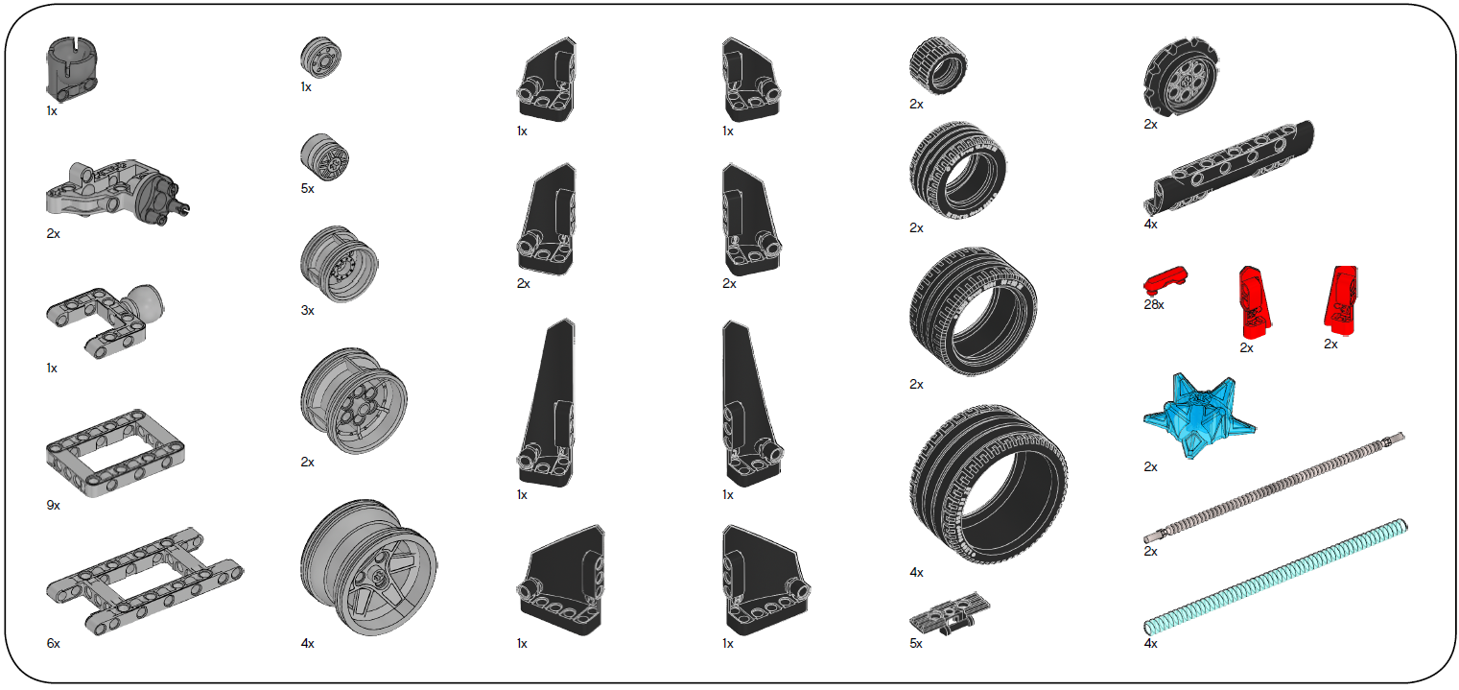
EV3 Expansion Set (45560) Bottom Tray Organizer

